Slide 1

Python! Day 12
Turtle
Tuples
Downloading packages

Slide 2
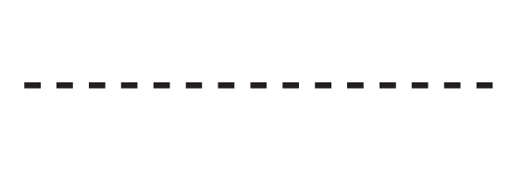
Warm-up: Dashed Line
Let’s start coding by creating a “Turtle Project” folder and opening up a new Python file in that folder
Once we have our new main.py file, we’ll import the turtle module using “from turtle import Turtle, Screen”
Next, we’ll set up our document by creating a turtle object and a screen object and using the screen.exitonclick() method
Finally, we’ll do a quick project with the turtle module: we’ll make the turtle draw a dashed line

Slide 3
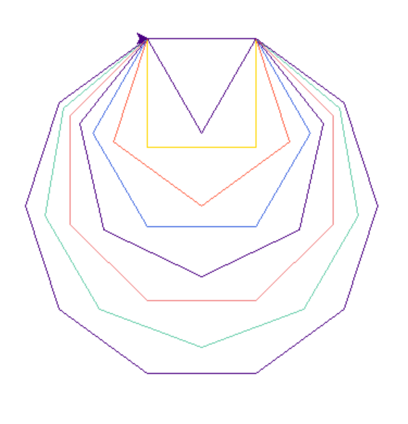
Project: Draw Shapes
Previously, we’ve drawn squares using turtle, now, let’s draw more shapes
Let’s write a program that draws a triangle (3 sides), square (4 sides), pentagon (5), hexagon (6), heptagon (7), octagon (8), nonagon (9), and decagon (10)
Each shape should also be drawn in a different, randomly selected color

Slide 4
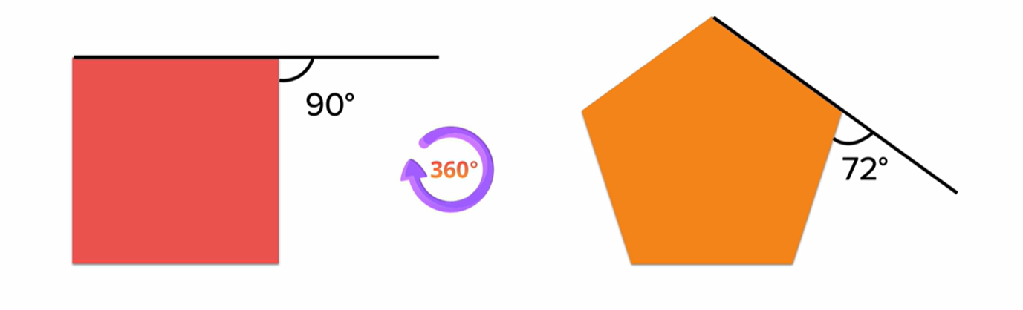
360 degrees is the angle to go in a whole circle
For a triangle, we need to turn 120 degrees. For a square, we must turn 90 degrees. And for a pentagon, we must turn 72 degrees
So, following this pattern, the angle needed to turn to create a shape is 360 degrees/number of sides
360 / 3 = 120
360 / 4 = 90
360 / 5 = 72
Using this rule, we can use a for loop to draw all the different shapes
To change the color of the turtle, we can create a list of different colors found after Googling “python turtle colors” and use the random.choice() method found in the random module documentation to choose one randomly

Slide 5
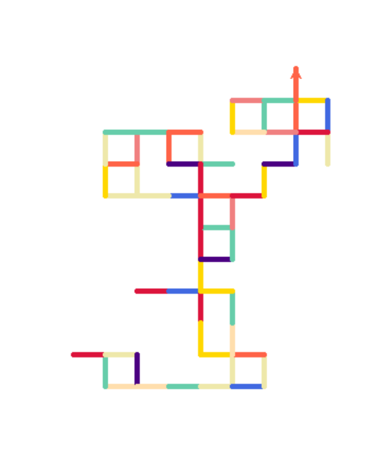
Project: Random Walk
Next, let’s use the same colors to program a random walk
This works by allowing the turtle to turn left/right/go forward/go backward randomly
Let’s also randomly change the color between each movement using the same list we created previously
Finally, let’s make the turtle move faster and make the pen thicker

Slide 6
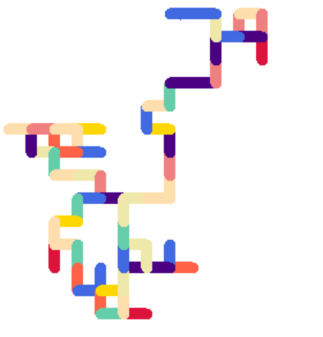
We can use the turtle.speed() and turtle.width() methods to change the speed and width of the drawing
To choose how much the turtle turns, we can multiply 90 by a random number between 0 and 3.
90 * 0 would make the turtle go straight, 90 * 1 would make the turtle turn right, 90 * 2 would make the turtle turn backwards, and 90 * 3 would make the turtle turn left
Finally, we can put this all in a for loop and make the turtle move randomly 100 times

Slide 7
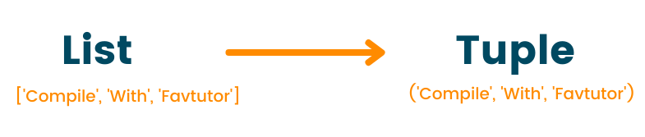
Tuples
Before moving on to the next project, let’s learn about a new data structure called a tuple.
A tuple is another way of organizing data like lists and dictionaries
Creating a tuple looks like this: new_tuple = (item_1, item_2, item_3,…)
Accessing a tuple value looks like this: new_tuple[index]
The difference between tuples and lists is that you cannot change a tuple after it’s created
You cannot add, remove, or change a tuple
Try it out
This is useful if you have something like a color scheme for a website that you don’t want to be accidentally changed

Slide 8
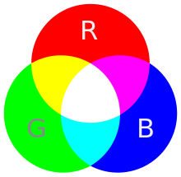
Using Tuples to Create Colors
If we look at the turtle.color() method documentation, we can create a color using a tuple with red, green, and blue values between 0 and 255
This uses a tuple because usually, programmers don’t need to change colors after creating them
Let’s use this to replace our color list with randomly generated colors
First, to do this, we need to change out the turtle color mode to accept rgb tuple values
To do that, we can write: turtle.colormode(255)
Now, we can write a random_color() function that returns a random color tuple

Slide 9
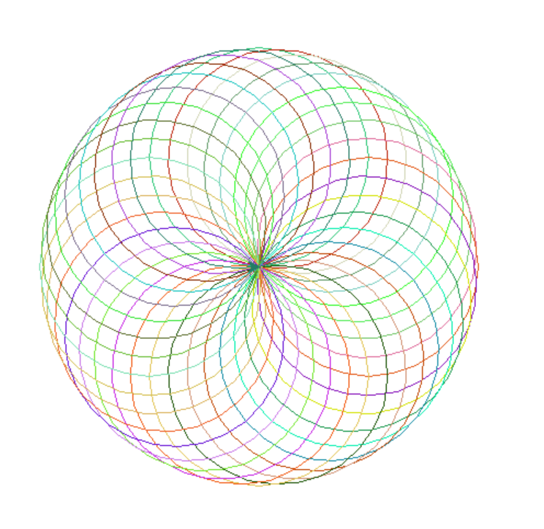
Project: Spirograph
For this last mini-project, let’s create a spirograph design
For this one, we’ll create a design with a certain number of circles overlapping with each other
All circles will have a radius of 100
Let’s also make the color change randomly between circles
For this, we’ll need to use the turtle.circle() method

Slide 10
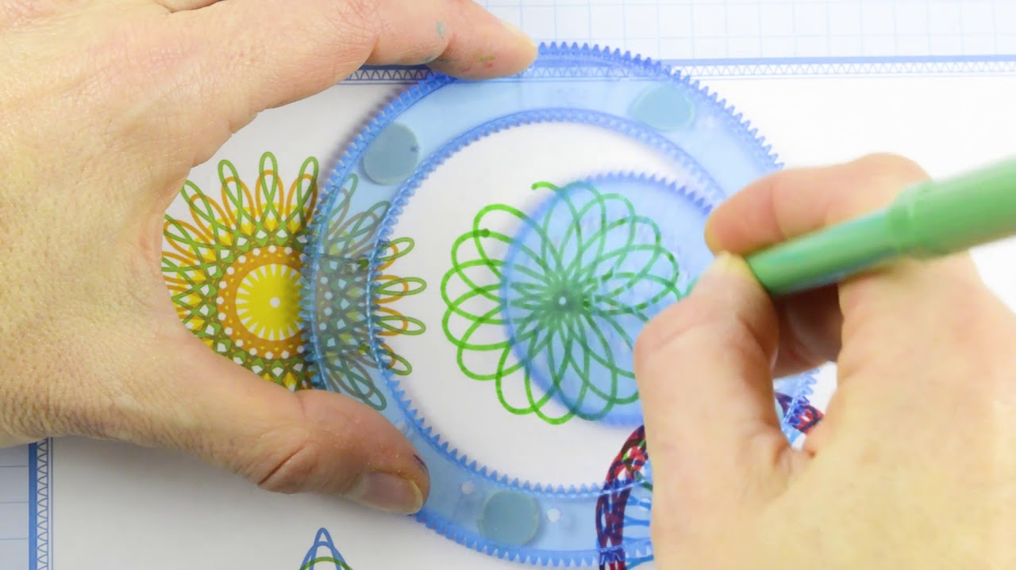
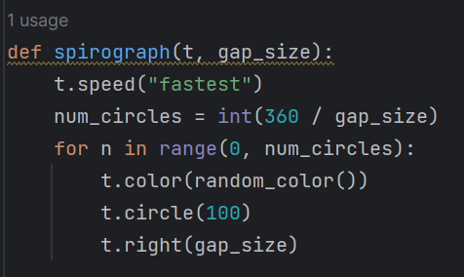
We should start by setting the speed to the fastest
Let’s make our function take the gap between the circles as an input
We can use that to calculate the number of circles the program needs to draw
Let’s also use our new random_color() function to pick a random color

Slide 11

Downloading Packages in Python
Last class, we learned how to create our own classes and objects, and how to use objects and modules built into Python
We can also use objects and classes created by other people by downloading “packages”
After downloading and installing a Python package found on the internet, we can import it into our program just like how we import turtle
Then, we can use code created by other people to save time and effort
One website that’s good for finding packages is Pypi.org
For example: if you want to create a table, you can search for pretty table in Pypi and you can download and use the PrettyTable package instead of coding it yourself

Slide 12
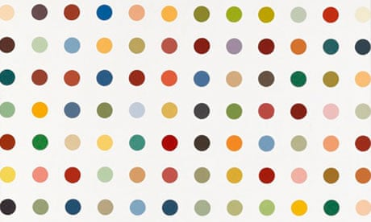
Project: Damien Hirst Spot Painting
This is an image of a Damien Hirst Spot painting, which sold for over $1,000,000
For the final project of the day, let’s recreate a Spot painting in Python
To start, let’s download a Python package that creates a color scheme based on an image so we can get a Damien Hirst color scheme
We can do this by going to Pypi and searching “colorgram”
This is the package we’ll use

Slide 13
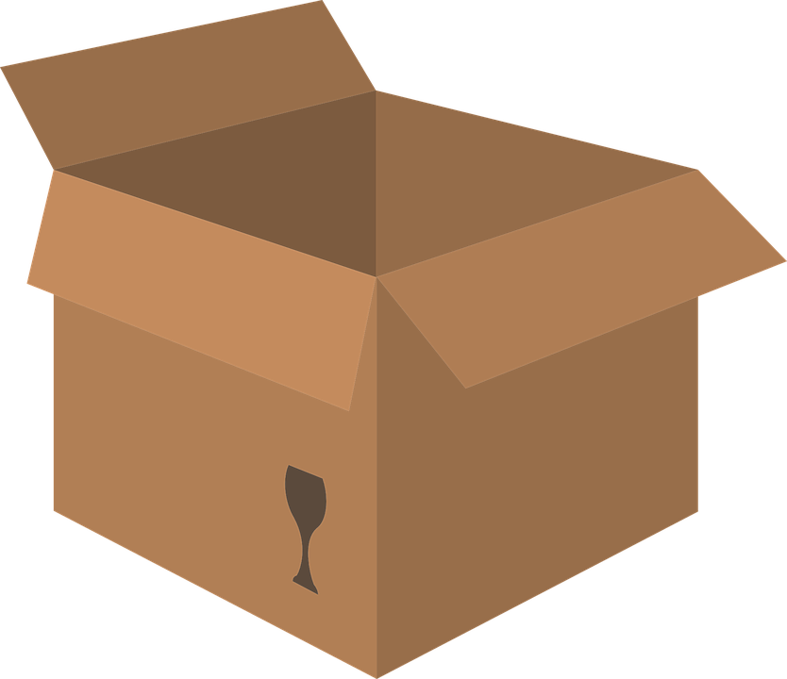
Next, let’s go to our PyCharm file and press File > Settings (Windows) or PyCharm > Preferences (Mac) and select the current project > Python Interpreter
Then, press the plus button and search for colorgram
Then, press install package and return to our PyCharm file
Finally, we can write import colorgram in our file to finish importing the module

Slide 14
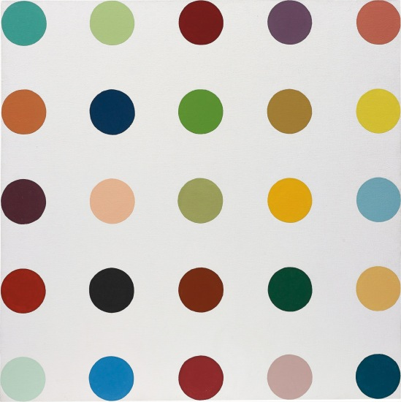
Accessing an Image in Python
The next step in our project is to get a Damien Hirst painting image to steal the colors from
To do this, let’s download an image from Google by searching for a spot painting, pressing “save as,” and save it as “painting.jpg.”
Next, we’ll want to take our downloaded image and drag it into our PyCharm screen to put it into our project file
Then, let’s write colors = colorgram.extract(‘painting.jpg’, 30) to get 30 colors from the image
Note: your image file must be at the same indentation level as your main.py file for this to work

Slide 15
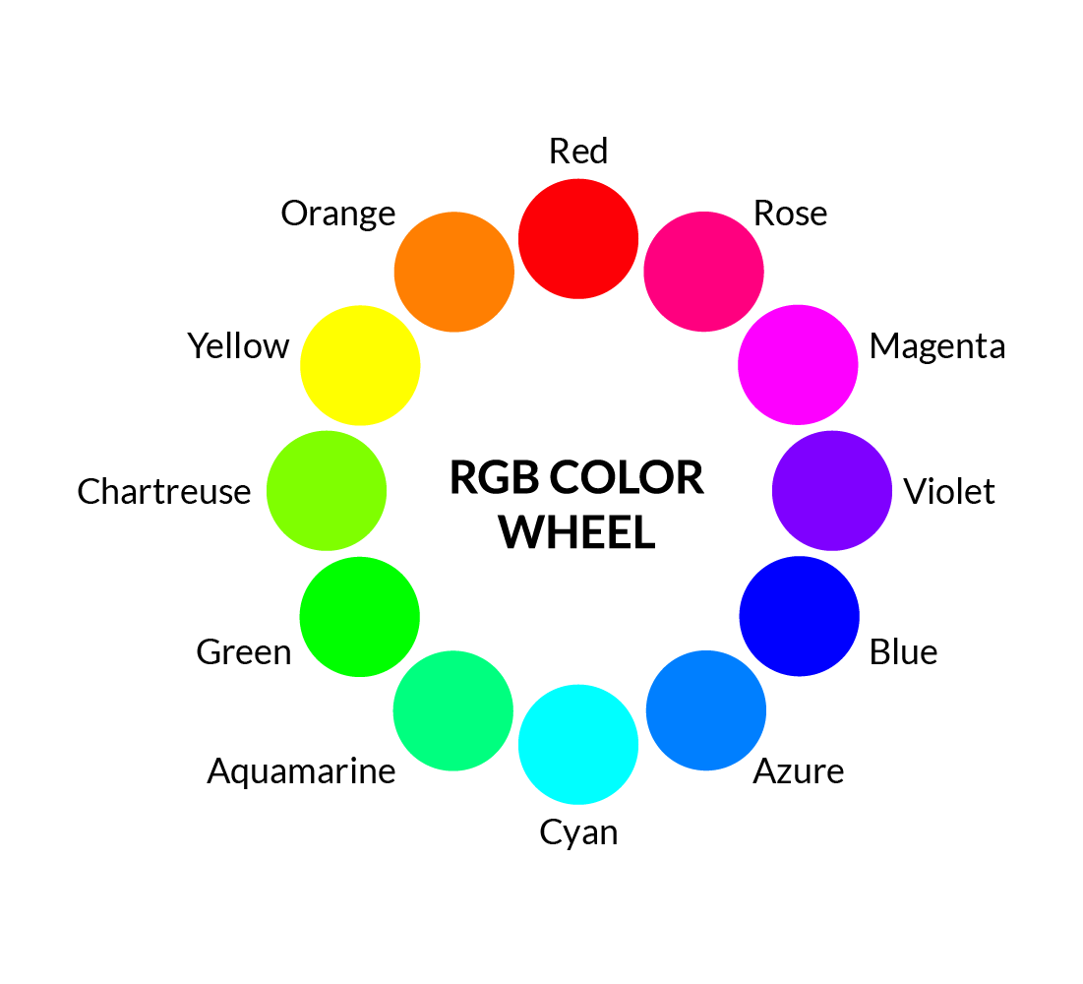
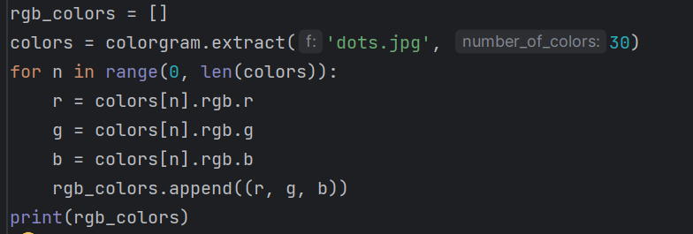
Getting a List of RGB Colors
Right now, our color variable has a lot of unnecessary information in it
Let’s use a for loop to get just the RGB tuples of each color
Next, let’s copy and paste the printed list into Python and get rid of any values where all 3 of the color values are close to 255 because those are from the background, and we don’t want them

Slide 16
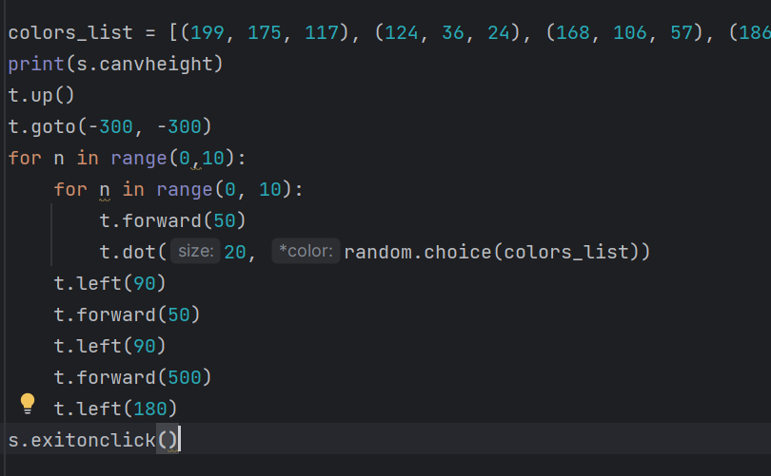
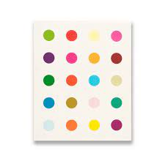
Drawing the Dots
For our painting, we’ll create a block of dots with 10 rows and 10 columns
The dots will be size 20, and they will be 50 units apart
For this, we’ll use the turtle.dot(size, color) method

